Slide 1
MODULE 3
http://www.youtube.com/c/EDULINEFORCSE
STUDENTS
1
CHAPTER 2
JAVA INPUT OUTPUT (I/O) & FILES
Prepared By Mr.EBIN PM, AP, IESCE

Slide 2
Streams
Java programs perform I/O through streams.
• A stream is an abstraction that either produces or consumes information.
• A stream is a sequence of objects that supports various methods.
• A stream is linked to a physical device by the Java I/O
system.
Input stream may refer to different kinds of input: from a disk file, a keyboard, or a network socket
Output stream may refer to the console, a disk file, or a network

Slide 3
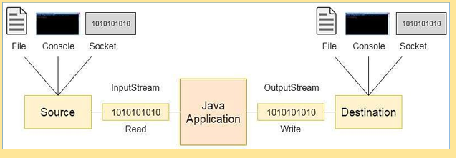
Working of I/O Stream
Stream is like a flow of data

Slide 4
Streams
• The java.io package contains all the classes required for
input and output operations.
• Java defines two types of streams: byte and character.
• Byte streams provides a means for handling input and output of bytes.
— Byte streams are used when reading or writing binary data.
• Character streams provide a means for handling input
and output of characters.
— they use Unicode.
— in some cases, character streams are more efficient than byte

Slide 5
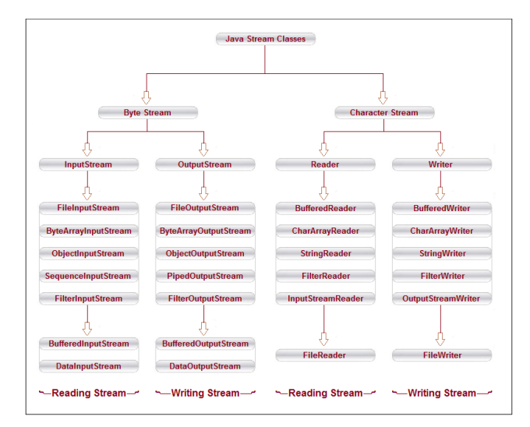

Slide 6
ByteStream Classes
• Byte streams are defined by using two class hierarchies.
• At the top are two abstract classes:
– InputStream and OutputStream.
• Two important methods are read( ) and write( )

Slide 7
CharacterStream Class
• Character streams are defined by using two class hierarchies.
• At the top are two abstract classes:
– Reader and Writer.
• Two important methods are read( ) and write( )

Slide 8
The Predefined Streams
•All Java programs automatically import the java.lang package.
This package defines a class called System.
• System contains three predefined stream variables:
– in, out, err.
– These fields are declared as public, static, and final within System.

Slide 9
• System.out refers to the standard output stream.
• System.in refers to standard input, which is the keyboard by default.
• System.err refers to the standard error stream, which is the console by default.
• System.in is an object of type InputStream
System.out and System.err are objects of type PrintStream.

Slide 10
READING CONSOLE INPUT
In Java, there are three different ways for reading input from the user in the command line environment(console).
1.Using Buffered Reader Class
This is the Java classical method to take input, Introduced in JDK1.0.
This method is used by wrapping the System.in (standard input stream) in an InputStreamReader which is wrapped in a BufferedReader, we can read input from the user in the command line.
Advantage - The input is buffered for efficient reading
Drawback - The wrapping code is hard to remember.
Prepared By Mr. EBIN PM, AP, IESCE

Slide 11

// Java program to demonstrate BufferedReader to read a letter
import java.io.*;
public class Testch{
public static void main(String[] args) throws IOException{
char ch;
//Enter data using BufferReader
BufferedReader reader =
new BufferedReader(new InputStreamReader(System.in));
System.out.println("Enter letter");
ch=(char)reader.read();
System.out.println("Letter="+ch);
} }

Slide 12
// Java program to demonstrate BufferedReader to read a string
import java.io.*;
public class Test{
public static void main(String[] args) throws IOException{
//Enter data using BufferReader
BufferedReader reader =
new BufferedReader(new InputStreamReader(System.in));
String name = reader.readLine(); // Reading string using readLine
System.out.println(name); // Printing the string
} }
Notes:
An InputStreamReader is a bridge from byte streams to character streams: It reads bytes and decodes them into characters using
a specified charset .

Slide 13
2. Using Scanner Class
This is probably the most preferred method to take input.
The main purpose of the Scanner class is to parse primitive types and strings using regular expressions, however it is also can be used to read input from the user in the command line.
Advantages:
Convenient methods for parsing primitives (nextInt(), nextFloat(),
…) from the tokenized input.
Regular expressions can be used to find tokens. Drawback:
The reading methods are not synchronized
Prepared By Mr. EBIN PM, AP, IESCE

Slide 14
import java.util.Scanner;
class GetInputFromUser{
public static void main(String args[]){
Scanner in = new Scanner(System.in);
String s = in.nextLine();
System.out.println("You entered string "+s);
int a = in.nextInt();
System.out.println("You entered integer "+a);
float b = in.nextFloat();
System.out.println("You entered float "+b);
}}
Input
HelloStudents
12
3.4
Output
You entered string HelloStudents
You entered integer 12
You entered float 3.4
http://www.youtube.com/c/EDULINEFORCSE
STUDENTS

Slide 15
3. Using Console Class
It has been becoming a preferred way for reading user’s input from the command line.
In addition, it can be used for reading password-like input without echoing the characters entered by the user; the format string syntax can also be used (like System.out.printf()).
Advantages:
Reading password without echoing the entered characters.
Reading methods are synchronized.
Format string syntax can be used.
Drawback: Does not work in non-interactive environment (such as in an IDE).
Prepared By Mr. EBIN PM, AP, IESCE

Slide 16
http://www.youtube.com/c/EDULINEFORCSE
STUDENTS
// Java program to demonstrate working of System.console()
// Note that this program does not work on IDEs as
// System.console() may require console public class Sample
{
public static void main(String[] args)
{
// Using Console to input data from user String name = System.console().readLine();
System.out.println(name);
}
}
Prepared By Mr.EBIN PM, AP, IESCE EDULINE
Notes:
Console class provides methods to access the character-based console device, if any, associated with the current Java virtual machine. The Console class was added to java.io by JDK 6. Important Points: It is used to read from and write to the console, if one exists.

Slide 17
WRITING CONSOLE OUTPUT
Console output is most easily accomplished with print() and println() methods.
These methods are defined by the class PrintStream which is the type of object referenced by System.in.
Because the PrintStream is an output stream derived from the OutputStream, it also implements the low-level method write().
Thus, write() can be used to write to the console. The simplest form of write() defined by the PrintStream is shown below :
void write(int byteval)
Prepared By Mr. EBIN PM, AP, IESCE

Slide 18
// Example that uses write() to output the character 'X' followed by //a newline to the screen using System.out.write
public class WriteConsole
{
public static void main(String[] args)
{
int y;
y='X';
System.out.write(y);
System.out.write('\n');
}
}
Output
X

Slide 19
PrintWriter Class
For real-world programs, the recommended method of writing to the console using Java is through a PrintWriter stream.
PrintWriter is one of the character-based classes
PrintWriter defines several constructors.
PrintWriter(OutputStream outputStream, boolean flushOnNewline)
Here outputStream is an object of type OutputStream, and flushOnNewline controls whether Java flushes the output stream every time a println( ) method is called.
– If flushOnNewline is true, flushing automatically takes place.
– If false, flushing is not automatic.

Slide 20
• PrintWriter supports the print and println( ) methods
• If an argument is not a simple type, the PrintWriter methods call the object’s toString( ) method and then print the result.
• To write to the console by using a PrintWriter, specify System.out for the output stream and flush the stream after each new line.
PrintWriter pw = new PrintWriter(System.out, true);

Slide 21
import java.io.*;
public class PrintWriterDemo {
public static void main(String args[]){
PrintWriter pw = new PrintWriter(System.out,true);
pw.println("This is a string");
int i = -7;
pw.println(i);
double d = 4.5e-7;
pw.println(d);
}}
Output
This is a string
-7
4.5E-7

Slide 22
Object Streams and Serialization
Object streams support I/O(input-output) of objects.
The object stream classes are
– ObjectInputStream
– ObjectOutputStream

Slide 23
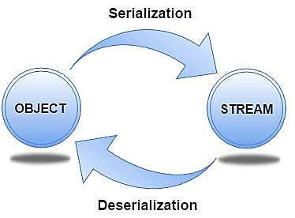
Serialization
Serialization is the process of writing(converting) the state of an object to a byte stream.
This is useful when we want to save(store) the state of the program to a persistent(permanent) storage area, such as a file or when we want to send it over network.
Later we can restore these objects by using the process of deserialization.
Deserialization converts byte streams into object.

Slide 24
Serialization is also needed to implement
Remote Method Invocation (RMI).
Interfaces that support serialization are:
Serializable
Externalizable
Advantages of Serialization
To save/persist state of an object.
To travel the state of an object across a network
(marshaling)

Slide 25
Serializable
Only an object that implements the Serializable interface can be saved and restored by the serialization facilities.
The Serializable interface defines no members.
It is simply used to indicate that a class may be serialized.
If a class is serializable, all of its subclasses are also serializable.
Variables that are declared as transient and static
variables are not saved by the serialization facilities.

Slide 26
Externalizable
Much of the work to save and restore the state of an object occurs automatically.
But the programmer may need to have control over these processes. eg: It may be desirable to use compression or encryption techniques.
The Externalizable interface is designed for these situations.
The Externalizable interface defines these two methods:
void readExternal(ObjectInput inStream) throws IOException, ClassNotFoundException
void writeExternal(ObjectOutput outStream) throws IOException

Slide 27
ObjectOutputStream
The ObjectOutputStream class extends the OutputStream class and implements the ObjectOutput interface.
It is responsible for writing objects to a stream.
A constructor of this class is
ObjectOutputStream(OutputStream outStream) throws
IOException
where outStream is the output stream to which serialized objects will be written.
Important Methods
final void writeObject(Object obj)- Writes obj to the invoking stream
void close( ) -Closes the invoking stream
void flush( ) -flushes the output buffers

Slide 28
ObjectInputStream
The ObjectInputStream class extends the InputStream class and implements the ObjectInput interface.
ObjectInputStream is responsible for reading objects from a stream.
A constructor of this class is
ObjectInputStream(InputStream inStream) throws IOException
where inStream is the input stream from which serialized
objects should be read.
Important Methods
Object readObject( )- Reads an object from the invoking stream
void close( ) -Closes the invoking stream.

Slide 29
Eg: of Java Serialization
We are going to serialize the object of Student class. The writeObject() method of ObjectOutputStream class provides the functionality to serialize the object. We are saving the state of the object in the file named f1.txt.

Slide 30
import java.io.*;
class Student implements Serializable{
int r;
String name;
public static void main(String args[]){
try {
Student s1=new Student(); // Creating the object
s1.r=12;
s1.name="Ravi";
//Creating stream and writing the object
FileOutputStream fout= new FileOutputStream("f1.txt");
ObjectOutputStream out=new ObjectOutputStream(fout);
out.writeObject(s1);
out. flush ( ) ;
out.close(); // closing the stream
System.out.println( "success " ) ; }

Slide 31
catch(Exception e)
{
System.out.println(e);
}
}}

Slide 32
Write a Java program that takes age as input and raise the exception if age is less than 18.(shows the usage of try, catch, throws and finally.)

Slide 33
import java.util.Scanner;
class AgeVerify{
void vote(int age) throws IllegalAccessException{
try{
if (age < 18){
throw new IllegalAccessException("You must be at least 18 years old to vote.");
}
else{
System.out.println("You can vote!");
} }
catch(Exception e){
System.out.println("EXCEPTION OCCURED: "+e);
}

Slide 34
finally{
System.out.println("Finally age verification done.");
}}}
public class Excep{
public static void main(String[] args) throws IllegalAccessException {
int age;
Scanner sc=new Scanner(System.in);
System.out.println("Enter age of voter.");
age=sc.nextInt();
AgeVerify av=new AgeVerify();
av.vote(age);
System.out.println("Verification completed successfully");
} }

Slide 35
Working with Files
• Java provides methods to read bytes from a file and write bytes to a file
Two of the most often used file stream classes are
• FileInputStream
FileInputStream class is an input stream to read data from a file in the form of sequence of bytes
• FileOutputStream
FileOutputStream class is an output stream for
writing data to a file
Notes:
In Java, all files are byte-oriented.

Slide 36
To open a file for reading
We have to create FileInputStream class object and pass filename as the parameter to the constructor.
• E.g. to open the file Sample.txt for reading
FileInputStream fileobject;
fileobject = new FileInputStream(“Sample.txt");

Slide 37
To open a file for writing
We have to create FileOutputStream class object and pass filename as the parameter to the constructor.
• E.g. to open the file Sample.txt for writing
FileOutputStream fileobject;
fileobject = new FileOutputStream(“Sample.txt");

Slide 38
Closing a file
• After completing file read or write operations, we should
close the file by calling close( ).
• It is defined by both FileInputStream and FileOutputStream
void close( ) throws IOException

Slide 39
E.g. to close file Sample.txt opened for reading
FileInputStream fileobject;
fileobject = new FileInputStream("Sample.txt");
//statements for reading the file
fileobject.close();

Slide 40
Read a file
To read data from a file,
1.Create FileInputStream class object and pass filename as the parameter to the constructor
FileInputStream fileobject;
fileobject = new FileInputStream(“Sample.txt");
2. Use a version of read( ) that is defined within FileInputStream.
int read( ) throws IOException
eg. int c=fileobj.read();
• Each time read() called, it reads a single byte from the file and returns the byte as an integer value.
read( ) returns –1 when the end of the file is encountered.
read() can throw an IOException

Slide 41
//Write a program to read &display the contents in the file Sample.txt
import java.io.*;
class Readfile{
public static void main(String arg[]) throws IOException {
FileInputStream f=null;
try {
f= new FileInputStream("Sample.txt");
int c;
do{
c=f.read(); //read one byte from file and store in integer variable c
if(c!=-1)
{
System.out.print((char)c);// convert int to character and print
}
} while(c!=-1); //continues till end of file
}

Slide 42
catch(FileNotFoundException e)
{
System.out.println("File not found");
return;
}
f.close();
}
}

Slide 43
Steps to write data to a file
To write data to a file,
1.Create FileOutputStream class object and pass filename as the parameter to the constructor.
2. Using write function store the byte value in file.
Eg:
int c=65;
FileOutputStream fileobject;
fileobject = new FileOutputStream(“Sample.txt");
fileobject.write(c);

Slide 44
//Program to copy contents from test.txt to cp.txt
import java.io.*;
class Filecopy
{
public static void main(String args[]) throws IOException
{
FileInputStream f1=null;
FileOutputStream f2=null;
try
{
f1=new FileInputStream("test.txt");
f2= new FileOutputStream("cp.txt");
int c;

Slide 45
do
{
c=f1 .read();
if(c!=-1)
{
f2.write((char)c);
System.out.print((char)c);
}
}while(c!=-1);
}
catch(FileNotFoundException e){
System.out.println("Filenotfound");
return;
}
f1 .close();
f2.close(); }}

Slide 46
//Program to read file when file name given as command line argument
import java. io.* ;
class Readcommandline{
public static void main(String arg[]) throws IOException
{
FileInputStream f=null;
try
{
f= new FileInputStream(arg[0]);
int c;
do{
c=f.read();
if(c!=-1)
{
System.out.print((char)c);
}
}while(c!=-1);
}
catch(FileNotFoundException e)
{
System.out.print("File not found");
return;
}
f.close(); } }
Execution:
java Readcommandline test.txt

Slide 47
FileReader
The FileReader class creates a Reader that we can use to read the contents of a file.
• Its two most commonly used constructors are:
FileReader(String filePath)
FileReader(File fileObj)
They can throw a FileNotFoundException.
filePath is the full path name of a file, and fileObj is a File object that describes the file.

Slide 48
FileWriter
FileWriter creates a Writer that you can use to write to a file.
Its most commonly used constructors are: FileWriter(String filePath)
FileWriter(String filePath, boolean append)
FileWriter(File fileObj)
FileWriter(File fileObj, boolean append)
– They can throw an IOException. Here, filePath is the full path name of a file, and fileObj is a File object that describes the file.
– If append is true, then output is appended to the end of the file.

Slide 49
Write a Java program that read from a file and write to file by handling all file related exceptions

Slide 50
import java.io.*;
import java.util.Scanner;
class WriteRead {
public static void main(String[] args) throws IOException
{
int ch;
try {
Scanner sc=new Scanner(System.in);
System.out.println("enter the text to file");
String s=sc.nextLine();
FileWriter fw = new FileWriter("WritedSample.txt");
fw.write(s); //write to file
FileReader fr = new FileReader("WritedSample.txt");

Slide 51
while ((ch = fr.read()) != -1)
{
System.out.print((char) ch);
}
fr.close();
fw.close();
}
catch (FileNotFoundException e) {
System.out.println(e.getMessage());
}
catch (IOException e) {
System.out.println(e.getMessage());
}
finally {
System.out.println("Success");
}}}

Slide 52
eg: of FileReader with BufferedReader
import java.io.*;
class FileReaderDemo {
public static void main(String args[]) throws IOException
{
FileReader fr = new FileReader("Sample.txt");
BufferedReader br = new BufferedReader(fr);
String s;
while((s = br.readLine())!= null)
System.out.println(s);
fr.close();
}}

Slide 53
Write a file handling program in Java with reader/writer.
Notes:
FileInputStream is Byte Based, it can be used to read bytes. FileReader is Character Based, it can be used to read characters. FileInputStream is used for reading binary files. FileReader is used for reading text files in platform default encoding.

Slide 54
import java.io.*;
class FileReadWrite{
public static void main (String [] args) throws IOException
{
int ch;
FileReader fr = new FileReader("sample.txt");
FileWriter fw = new FileWriter("WritedSample.txt");
while((ch = fr.read()) != -1)
{
fw.write((char) ch);
System.out.print((char) ch);
}
fr.close();
fw.close();
}}

